Slide 1
kate pullinger
Landing Gear: a novel
with two digital companions

Slide 2

books!
seven novels
three story collections

Slide 3
digital fiction!
works that combine text with images, video, sound effects, music, animation, and games
existing in parallel to my work as a literary novelist and short story writer
Notes:
since 2002 - teaching online - year-long fellowship - must collaborate - new hybrid forms - collaborative - sometimes networked - lots of projects - show 3 now

Slide 4

Flight Paths: A Networked Novel
Notes:
man falling - started in a blog, commentpress widget - 100 contributors - 5 epis + 1

Slide 5
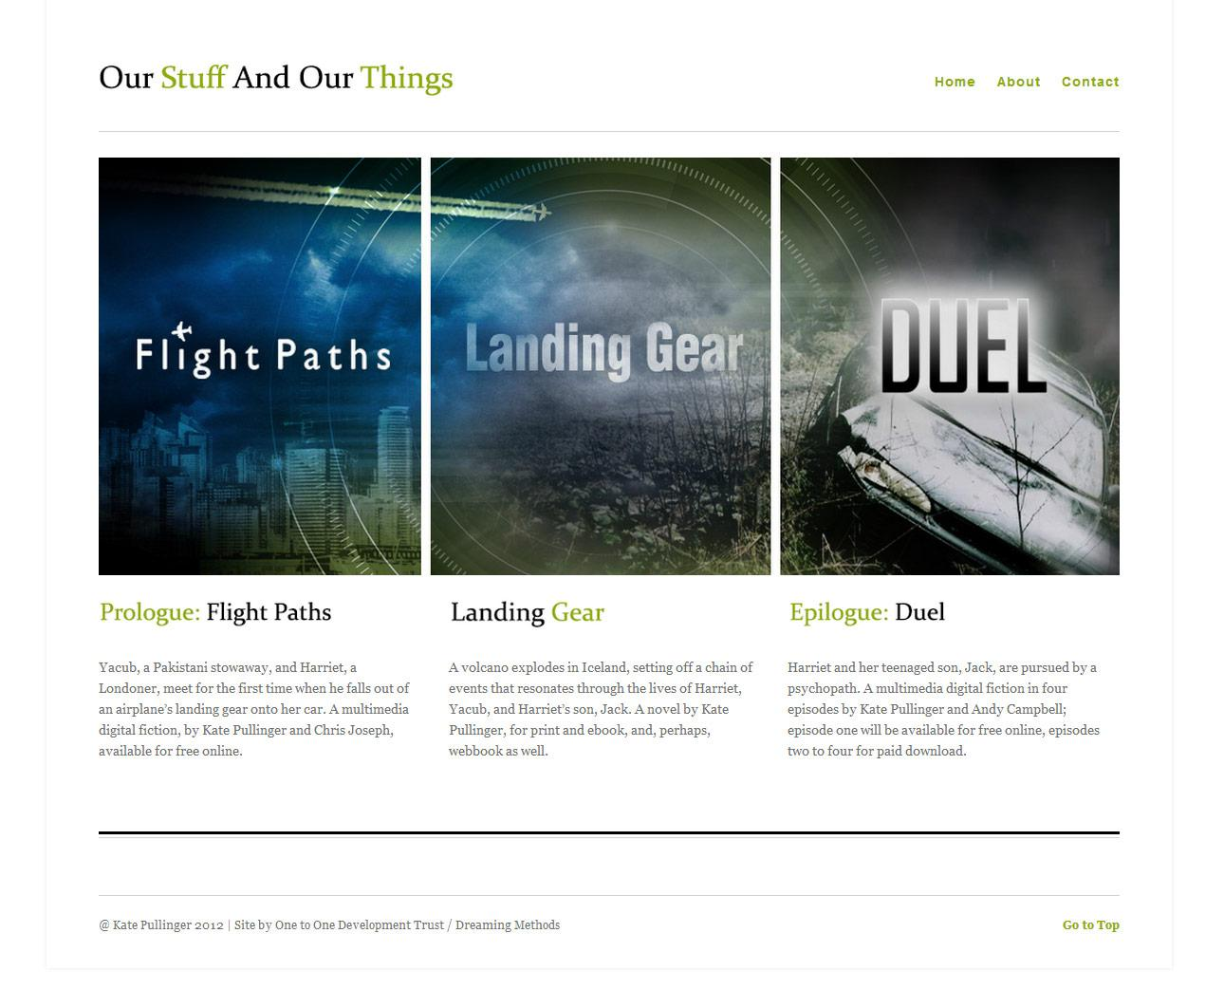
Our Stuff and Our Things

Slide 6
Duel
prototype
Notes:
works across all devices and platforms, from smartphones to tablets - desktop prototype

Slide 7
kate pullinger
http://www.katepullinger.com
thank you

